Slide 1

Disaster Recovery and High Availability
Azure Stack Hub Business Continuity and Disaster Recovery
This work is licensed under a Creative Commons Attribution - ShareAlike 4.0 International Public License

Slide 2
Agenda
Overview
Infrastructure Backup and Cloud Recovery
HA and DR Patterns
User Backup and Restore
Protecting Workloads
DevOps and BC/DR

Slide 3
Overview

Slide 4
BC/DR consistency between Azure and Azure Stack Hub is a journey that continues to progress as capabilities are added over time.

Slide 5
Topics for today
Cloud user
Azure Stack Hub
I can protect applications deployed on IaaS
I can create a protection strategy for PaaS based
Managed Services Provider
I can recover Azure Stack Hub infrastructure
Operator

Slide 6
Level set on terminology
Business Continuity and Disaster Recovery (BC/DR)
BC/DR are closely related practices that describe an organization's preparation for unforeseen risks to continued operations
BC/DR refers to a strategy that a company implements
The implementation of a BC/DR strategy will determine the protection schemes technologies that will help a company achieve their recovery objectives
For the purposes of this discussion, we need to start by level setting on some concepts:
Site level availability
Physical and logical layering within a cloud
Fault tolerance within a scale-unit

Slide 7
Deployment site
Utility Feed
Backup generator
N: Tier I
N+1: Tier II
Auto transfer switch (ATS)
Active:
Tier 1 and II
Mechanical
Uninterruptible power supply
UPS
N: Tier I
N+1: Tier II
Site
https://uptimeinstitute.com/resources/asset/tier-standard-topology

Slide 8
Deployment site
Utility Feed A
Backup generator
N: Tier III
N+1: Tier IV
Backup generator
N: Tier III
N+1: Tier IV
Utility Feed B
Auto transfer switch (ATS)
Azure
Stack
Auto transfer switch (ATS)
Azure
Stack
Passive:
Tier III
Active:
Tier IV
Active:
Tier III and IV
Azure
Stack
Mechanical
Mechanical
UPS
N: Tier III
N+1: Tier IV
UPS
N: Tier III
N+1: Tier IV
Site
https://uptimeinstitute.com/resources/asset/tier-standard-topology

Slide 9
Site level failure
Utility Feed A
Backup generator
N: Tier III
N+1: Tier IV
Backup generator
N: Tier III
N+1: Tier IV
Utility Feed B
Auto transfer switch (ATS)
Auto transfer switch (ATS)
Azure
Stack
Passive:
Tier III
Active:
Tier IV
Active:
Tier III and IV
Mechanical
Mechanical
UPS
N: Tier III
N+1: Tier IV
UPS
N: Tier III
N+1: Tier IV
Site
Impact radius of a disaster

Slide 10
Border Devices
Layer 3: BGP or Static route
Scale-unit
Leaf Switch (ToR)
PDU
PDU
Leaf Switch (ToR)
UPS
UPS
BMC Switch
Node1
Power distribution unit
Node2
Node(n)
Node16
Hardware Lifecycle Host
Rack

Slide 11
Scale-units do not stretch across datacenters or sites
Site level high availability: No
Site-aware workloads placement: No
Workload affinity to a site: No
Scale-unit
Scale-unit node
Scale-unit node
Scale-unit node
Scale-unit node
Scale-unit node
Scale-unit node
Scale-unit node
Scale-unit node
10km
Site
Site

Slide 12
Fault tolerance within a scale-unit
Border Devices
Administrator and user connectivity:
Top of rack switches (2):
4 uplinks to pair of border devices
Failure impact: None; one switch can handle all traffic
Scale-unit nodes
4-16 nodes configured in highly available topology
Hardware management:
BMC switch (1):
Impact: HW monitoring, some admin operations
Hardware Lifecycle host (1):
Impact: HW monitoring, some admin operations
Layer 3: BGP or Static route
Scale-unit
Leaf Switch (ToR)
Leaf Switch (ToR)
BMC Switch
Node1
Node2
Node(n)
Node16
Hardware Lifecycle Host
Rack

Slide 13



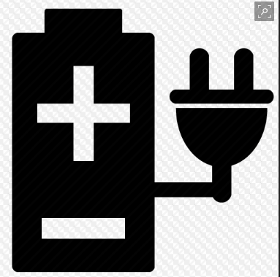
Fault tolerance within a scale-unit node
Node
Boot Drive
Boot
Drive
(if installed)
Leaf Switch (ToR)
Leaf Switch (ToR)
NIC
NIC
PDU
PDU
Power Supply
BMC
Power Supply

Slide 14
Azure Stack Hub Integrated System Single region/single scale-unit deployment
Site
Datacenter/Co-location/Room/Row
Rack
https://portal.mycloud.contoso.com https://adminportal.mycloud.contoso.com
Cloud
A
Azure Resource Manager
One set of mgmt and portal endpoints
1 region
1 scale units per region
4-16 scale-unit nodes
Azure Stack Hub services and user apps/data deployed across
A
B
B
Region (1)
C
C
Scale-unit (1)
D
Scale-unit nodes (4-16)
D
E
Applications and data
E
Azure Stack Hub Services

Slide 15
But as an admin, I still protect it like a virtual stack?
No!
Protecting, healing, and recovering Azure Stack Hub is fundamentally different from what you do today in Hyper-V environment
Co-engineered integrated solution
OEMs are the only authorized entity that can deliver deployment services
Recovering Azure Stack Hub will involve professional services
If hardware is unrecoverable, need to account for ordering a new solution
Appliance experience
Managed through admin portal – no Hyper-V Manager, no Failover Cluster Manager
There are no third-party agents installed on an Azure Stack Hub scale-unit’s fabric
All software on all nodes (including HLH) whitelisted by Microsoft
Locked down by default
Network ACLs limit traffic flow to pre-defined paths
Administrator access limited to break glass procedure through privileged endpoint

Slide 16
Do I still have a “catch-all” insurance policy?
No!
Protection of resources and resource data in Azure and Azure Stack Hub is a user responsibility
no way to backup or replicate data from the underlying hypervisor nodes
no bulk recovery of VMs directly into hypervisor nodes
The “catch-all” mechanism in Azure (GRS/RA-GRS) is not available in Azure Stack Hub yet
Modern apps (e.g. container, microservices) require a different approach to backup-recovery and disaster-recovery

Slide 17
Infrastructure Backup

Slide 18
Azure Stack Hub Infrastructure
Azure Stack Hub
I can protect applications deployed on IaaS
I can create a protection strategy for PaaS based
Infra backup
Cloud Recovery
Operator
Recover Azure Stack Hub data with the Infrastructure Backup Service - Azure Stack Hub | Microsoft Docs

Slide 19
Infrastructure Backup Controller
Backup Details
Full backups supported; incremental backups supported in 2102 and above.
Full backups only (~10 GB)
Encrypted using .NET libraries
Can be automatically scheduled (following update 1807)
Backup does not include network switch or hardware management server configuration.
Deployment documentation will include steps for backup of this data on the same external infrastructure backup share

Slide 20
Infrastructure backup requirements
Backup share
Customer provides SMB3 file share with at least 1TB of available capacity per cloud
\\fileserver\fileshare\
Customer must provide a subfolder layout for separate deployments
\\fileserver\fileshare\<subfolder>\
Customer can use the same file share for multiple deployments (unique subfolder for each deployment)
File share must not be hosted on Azure Stack Hub or the HLH
Azure files currently not supported as a backup location
Backup share credential
Customer provides an account with read/write access to the share
Encryption key
Symmetric key required to encrypt backup payload before it is placed on external share

Slide 21
Configuring backups – The process
Provide backup storage UNC path in admin portal or PowerShell
Provide username and password to backup share
Provide a backup frequency in hours between 4 and 12
Set retention period in days, between 2 and 14. (Backups older than maximum retention period are deleted)
Provide pre-shared key to encrypt backup files

Slide 22
Infrastructure backup requirements
Share path examples:
Share path | Content | Managed by
\\fs01.contoso.com\AzSBackups | Can contain backups from one or more Azure Stack Hub clouds | Customer
\\fs01.contoso.com\AzSBackups\mast.contoso.com | Backups from deployments that use mast.contoso.com external FQDN | Customer
\\fs01.contoso.com\AzSBackups\mast.contoso.com\nyc | Backup data for region called NYC | Customer
\\fs01.contoso.com\AzSBackups\mast.contoso.com\nyc\MASBackup | Azure Stack Hub infra backup data | Azure Stack Hub
NYC region subfolder examples:
Share path | Content | Managed by
\\fs01.contoso.com\AzSBackups\mast.contoso.com\nyc\HLH | Hardware lifecycle host config and data | Customer
\\fs01.contoso.com\AzSBackups\mast.contoso.com\nyc\Switches | ToR/BMC switch config | Customer
\\fs01.contoso.com\AzSBackups\mast.contoso.com\nyc\DeploymentData | Generated files for deployment | Customer
\\fs01.contoso.com\AzSBackups\mast.contoso.com\nyc\Registration | Activation data | Customer

Slide 23
Infrastructure backup controller
Azure Stack Hub separates infrastructure data from tenant data
Tenants of Azure Stack Hub are responsible for protecting their workloads and backing up data
Infrastructure data from multiple internal services is backed up by Azure Stack Hub using the Infrastructure Backup Controller service
Backup Configuration
Backup occurs periodically with no admin intervention and no downtime to the portal experience or APIs
Backup data is stored to an external/off-stamp SMB file share
Infrastructure backup is enabled at Azure Stack Hub deployment time. A file share UNC path and credentials are required
After deployment, backup can also be enabled using UI or APIs
Note: Traditional backup using Microsoft Data Protection Manager and Hyper-V capabilities are not used by Infrastructure Backup Controller

Slide 24
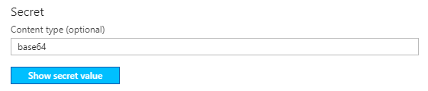
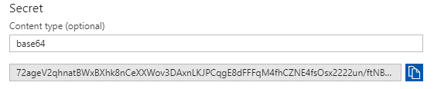
Considerations
Allocate at least 1Tb per Azure Stack Hub cloud
Recommendation: Keep at most 7 days of backups on the share. Manually archive or discard anything older than 7 days.
Neither Azure Files nor Azure Blob storage are supported
Encryption key must be stored external to the stamp
Recommendation: Use KeyVault in Azure to store the secret
Infrastructure Backup Service best practices - Azure Stack Hub | Microsoft Docs

Slide 25
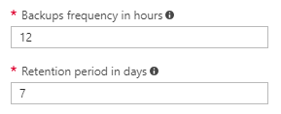
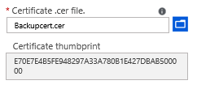
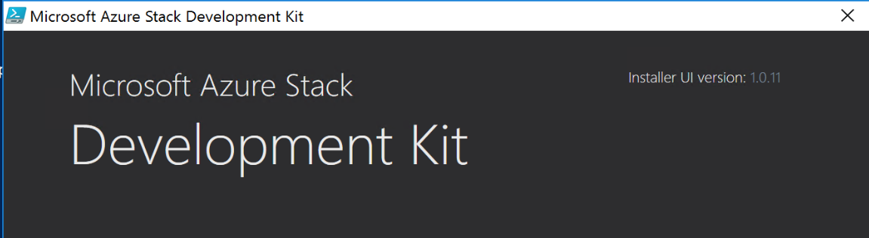
Infrastructure backup - released and planned updates
Automatic
Backups
Cloud recovery
on ASDK
Certificate wrapped key encryption
Configurable retention period and backup frequency
Automatic deletion of stale backups
New and improved alerts
Enable/disable automatic backups
Validate infrastructure backups using ASDK
No interruption to production deployment
Support for AAD and ADFS
Use public key in certificate to encrypt unique symmetric key generated with each backup
Provide private portion during recovery only.

Slide 26

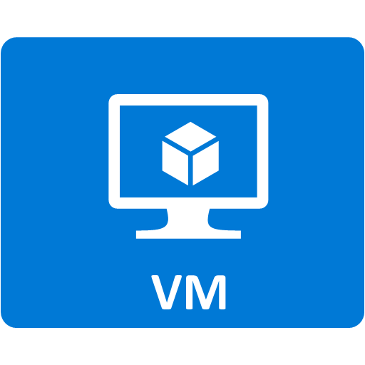
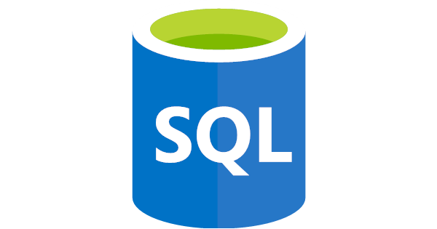
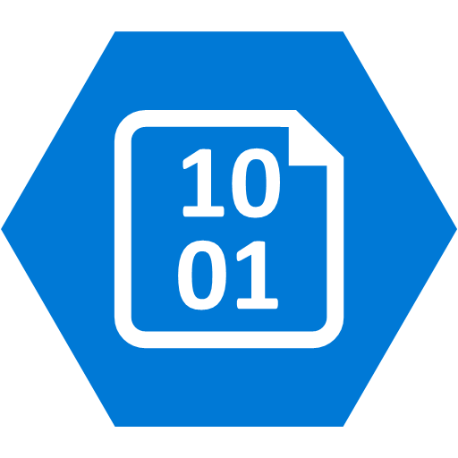




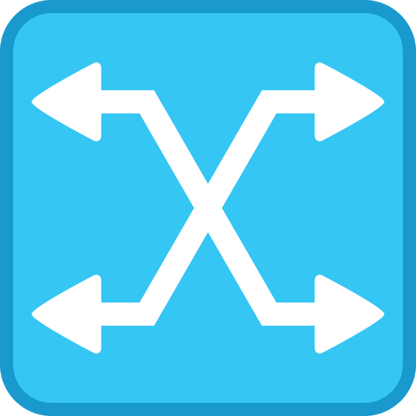
Backup of HLH and switches
Manually triggered via OEMs tools or scripts
OEMs will provide guidance to determine when restore from backup is necessary vs. configuration
Azure Stack Hub
User
Operator
IaaS
PaaS
Azure Stack Hub Infrastructure
External
File Share
HLH
ToR and BMC
switches

Slide 27
Azure Stack Hub cloud recovery
Goal: Recover your Azure Stack Hub infrastructure and user configuration after catastrophic data loss
Phase1
Phase2
PaaS restore
Phase3
IaaS VM restored
Phase4
User data restored
Phase 0
HW ready
Cloud recovery
HARDWARE PARTNER
OPERATOR
MANAGED SERVICE/USER
Order → manufacturing → delivery → Prof services on-site
Prof services on-site
Weeks
<1 week
Days
Hours to days to weeks
Phases: Recovery is separated into atomic phases that build on each other
Phase 0: Get the hardware ready
Phase 1: Cloud recovery - Restore Azure Stack Hub’s “personality”
Phase 2: Restore PaaS resources and data
Phase 3: Restore user IaaS VMs
Phase 4: Recover user data

Slide 28
Restore process
With catastrophic data loss but the hardware is still usable, redeployment of Azure Stack Hub is required. During redeployment, you can specify the storage location and credentials required to access backups.
Deployment mode | Starting point | End point
Clean install | Baseline build | OEM deploys Azure Stack Hub and updates to the latest supported version.
Recovery mode | Baseline build | OEM deploys Azure Stack Hub in recovery mode and handles the version matching requirements based on the latest backup available. The OEM completes the deployment by updating to latest supported version.
Recover from catastrophic data loss in Azure Stack Hub - Azure Stack Hub | Microsoft Docs

Slide 29
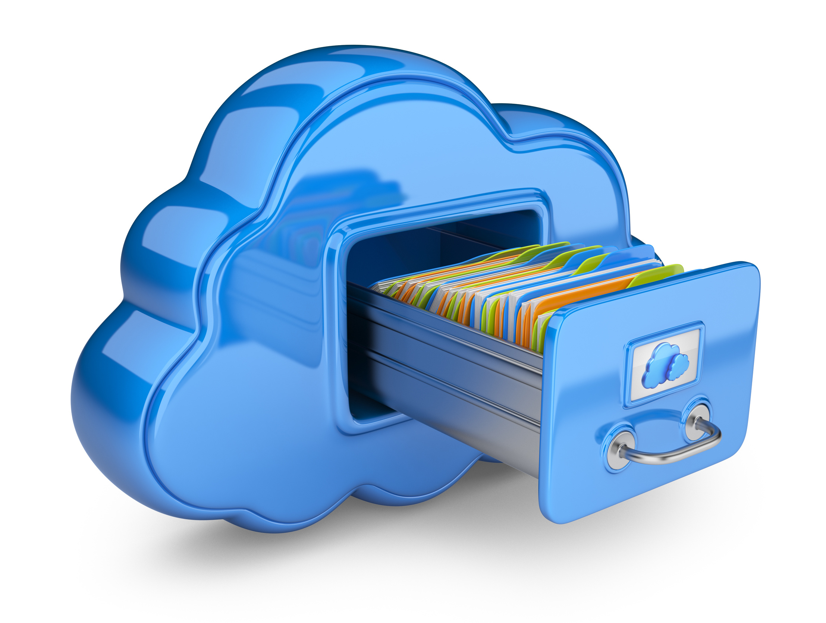
Contents of an infrastructure backup
Internal identity services
Backup of internal domain controller
Used to seed the domain in the new deployment
Deployment configuration
Deployment ID
Deployment parameters
CA root certificate
ADFS configuration
User subscriptions
- Admin/default subscriptions re-created during deployment
Original Plans/offers
Previously defined quotas for
Storage
Network
Compute
Key vault secrets
User RBAC roles and policies
RBAC for default subscription not restored
Resource groups
Not included in backup
Any resource group present after restore was recreated during the hydration of resources. Any meta-data about the resource group is not restored (e.g. tags)
What is included and not in an Azure Stack Infrastructure backup

Slide 30
Testing infrastructure restore with the ASDK
Want to test your infrastructure backup?
Prepare an Azure Stack Hub Development Kit (ASDK) host server using the current version of Azure Stack Hub
Copy the backup to a local folder on the ASDK
Deploy the ASDK in cloud recovery mode using the InstallAzureStackPOC.ps1 script
After a successful cloud recovery deployment, you need to complete the restore using the Restore-AzureStack cmdlet
Use the ASDK to validate an Azure Stack backup - Azure Stack Development Kit (ASDK) | Microsoft Docs

Slide 31
HA and DR patterns

Slide 32
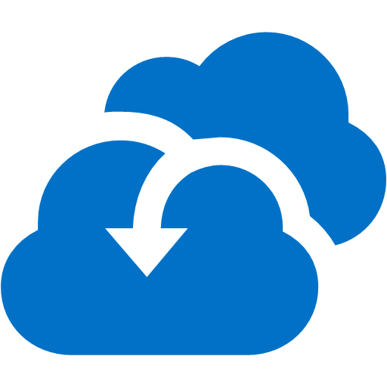

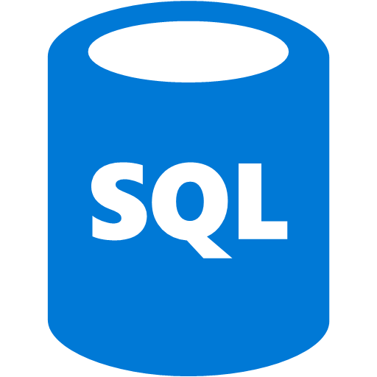


Disaster recovery between Azure Stack Hub and Azure
Azure
Azure/SP services
Service Provider
Azure Site
Recovery
Azure Backup
SQL IaaS
Azure App Service
Azure/SP services
Partner Backup
Partner Site Recovery
SQL IaaS
Azure App Service
Azure
Stack
Partner Backup
Partner Site Recovery
On-premises

Slide 33
Application availability between Azure Stack Hub and Azure Stack Hub (short distance/shared impact radius)
High Availability: Yes
Disaster recovery: No
Site A
Azure
Stack
Azure
Stack

Slide 34
Disaster recovery between Azure Stack Hub and Azure Stack Hub (long distance/separate failure domains)
Longer Distance
Higher Latency
Lower Bandwidth
Higher Data loss
Disaster recovery
Site A
Site B
What is your data loss tolerance?
Azure
Stack
Azure
Stack
What is your downtime tolerance?
Failure Domain
Failure Domain

Slide 35
Azure Stack Hub Deployment Patterns
Cloud user
Azure Stack Hub
I can protect applications deployed on IaaS
I can create a protection strategy for PaaS based
Managed Services Provider
I can recover Azure Stack Hub infrastructure

Slide 36

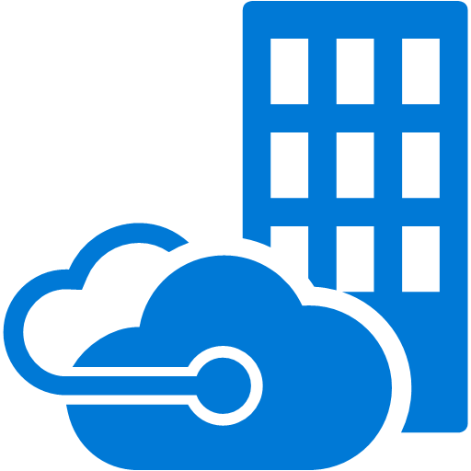
SQL: Multiple Deployments
SQL HA
SQL Always On
Web App
Disaster recovery
Load Balancer
HA
Site A
Site B
Asynchronous

Slide 37

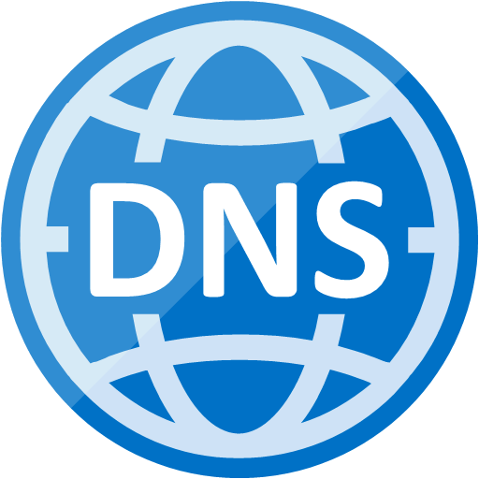

SQL site to site recovery behind VPN
Site 2 Site VPN
Availability group listeners
Accounts synchronized
Learnings
Web App
Load Balancer
Disaster recovery
HA
Active
Directory
Domain
name server
Site A
Site B
Asynchronous
Availability Set
Availability group
Synchronous
Site 2 Site VPN
Subnet
Virtual Network
Virtual Network

Slide 38
SQL distributed availability group
Availability group listeners
Forwarder is empty
Load Balancer
Learnings
Web App
Load Balancer
Disaster recovery
Distributed group
HA
HA
Site A
Site B
Asynchronous
Availability group
Availability group
Synchronous
Synchronous
Primary
Forwarder

Slide 39


App Service: Multiple deployments
Separate instance of RP
For DR: Redeploy app and restore user database
Use distributed group for application to be HA
Learnings
Disaster recovery
HA
HA
Site A
Site B
User App
Load Balancer
User App
Distributed group on the application layer e
SQL HA
SQL HA
SQL HA
SQL HA
App Service Component
App Service Component
SQL HA
SQL HA
File content
File content
SQL HA
SQL HA
File content
File content

Slide 40
Recovery Time Planning
Fault tolerance
Zero
Active
High availability
Seconds to minutes
Automatic Failover
Replication/ snapshot
Minutes to hours
Manual Failover/ Re-deployment
Backup
Hours to Days
Restore
Active
Azure Stack Hub integrated system
Fully deployed and registered
Or
Wait for hardware partner to deliver new integrated system
Azure Stack Hub integrated system
Warm
Public Azure
Always available

Slide 41
User VM Protection

Slide 42
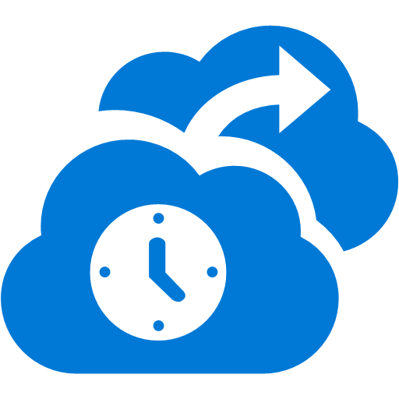


Data protection and recovery options
Can perform backup using standard on-premises tools, or cloud based offerings like Azure backup
Azure Site Recovery supports failover and failback
Azure Stack Hub
On-prem/remote
target
User
Operator
IaaS
PaaS
Azure Stack Hub Infrastructure
HLH
ToR and BMC
switches

Slide 43
User IaaS VM backup/restore
Public Azure
Secure connections using S2S VPN and ExpressRoute
Azure Stack Hub
Service Provider
Use existing products on-prem or remote
Tenant driven workflows
Existing backup tools can target several backup targets…
Azure Stack Hub Customer
Application, file/folder, and page-blob snapshot level snapshot
Support for Microsoft and 3rd party products
Service Provider

Slide 44
Support for IaaS VM backup/restore
Azure Backup supports backup and restore of IaaS VM
Support for live backup with no OS downtime (requires IaaS VM Extension)
Supports incremental and full backups of IaaS VMs
Supports ability to restore the IaaS VM instance (model) and virtual disks
Azure Stack Hub does not currently support the necessary storage APIs to enable IaaS VM backup
This is a well-known gap which forces the use of guest level backup
The decision is to focus on enabling Azure consistent backup and restore of IaaS VMs instead of implementing a stop gap/temporary that may break consistency
Partners can use the same APIs to enable backup/restore scenarios
Fosters a consistent model across Azure and Azure Stack Hub for ISVs integrating with Azure Stack Hub
Protect VMs deployed on Azure Stack Hub - Azure Stack Hub | Microsoft Docs

Slide 45
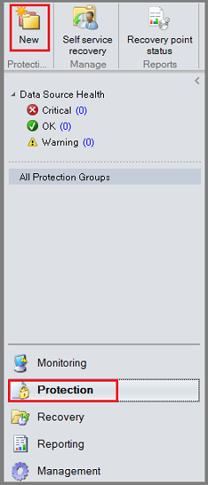
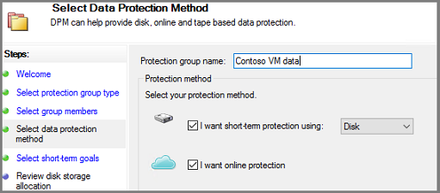
Microsoft Azure Backup server
Azure Backup requires a backup server VM
Install an Azure Backup Server VM in Azure Stack Hub
Add storage for local backups to the Azure Stack Hub VM
Select VMs to be protected
Choose short-term (local protection) and/or long-term protection (to Azure storage)
Install Azure Backup Server on Azure Stack - Azure Backup | Microsoft Docs

Slide 46
Support for IaaS VM replication - Summary
Azure Site Recovery supports replication of IaaS VM
Support for live backup with no OS downtime
Supports low RTO to Azure
Supports planned, unplanned, and test failover of IaaS VM instance (model and data)
Azure Stack Hub GA does not support the necessary storage APIs to enable IaaS VM replication
This is a well-known gap which forces the use of guest level replication
The decision is to focus on enabling Azure consistent replication and failover of IaaS VMs instead of implementing a stop gap/temporary that may break consistency
Partners can use the same APIs to enable replication and failover scenarios
Fosters a consistent model across Azure and Azure Stack Hub for ISVs integrating with Azure Stack Hub

Slide 47







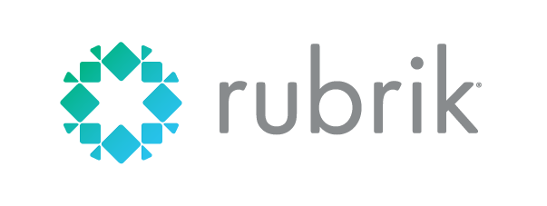



Azure Stack Hub BC/DR partners
https://azure.microsoft.com/en-us/blog/protecting-applications-and-data-on-azure-stack/
Partner - product name | Validation complete | More information
Azure Backup Server | Complete | https://azure.microsoft.com/en-us/blog/backup-your-applications-on-azure-stack-with-azure-backup/
Azure Site Recovery | Complete | https://docs.microsoft.com/en-us/azure/site-recovery/azure-stack-site-recovery
Acronis | Complete | https://acronis.com/business/backup
Actifio | Complete | https://www.actifio.com/azure-stack-data-protection
Carbonite | Complete | https://www.carbonite.com/data-protection/high-availability/
Commvault | Complete | https://www.commvault.com/solutions/by-technology/virtual-machine-and-cloud/microsoft-azure
Dell EMC | Complete | https://www.dellemc.com/en-us/solutions/cloud/microsoft-azure-stack.htm
Micro Focus | Complete | Press Release
Quest | Complete | Blog post
Rubrik | Complete | https://www.rubrik.com/solutions/azure-stack/
Veritas | Complete | https://www.veritas.com/solution/microsoft-cloud
ZeroDown | Complete | http://www.zerodownsoftware.com/azure-stack/

Slide 48
Protecting IaaS VMs in Availability Sets

Slide 49
Availability sets for IaaS VMs
In this case, we want to have protection for a multi-server VM environment using a load balancer and an availability set
Azure Stack Hub
User
Operator
IaaS
PaaS
Azure Stack Hub Infrastructure
HLH
ToR and BMC
switches

Slide 50

Availability sets and backup/restore
Scenarios
1 - Increase application availability in the event of planned maintenance
2 - Increase application availability in the event of unplanned failures/maintenance
Application patterns
Availability sets are ideal for stateless apps that can scale-in/out Applications that work well behind a load balancer
Application data is typically external to the IaaS VM
Backup implications
Protecting individual VMs does not guarantee complete application data set is captured with consistency.
Need to focus on protecting the application data repository(ies)
Deployment code takes care of OS boot/config
IaaS
PaaS
Infra
Archive

Slide 51
Protecting PaaS in Azure Stack Hub

Slide 52

Protecting PaaS data stores
PaaS BC/DR is application dependent. The focus is on building a process to take a consistent backup and perform a consistent restore.
Azure Stack Hub
User
Operator
IaaS
PaaS
Azure Stack Hub Infrastructure
HLH
ToR and BMC
switches

Slide 53
PaaS storage archiving (without cool storage)
Automated migration
Azure Backup, 3rd party backup/migration products, StorSimple
Manual migration
AzCopy, .Net Library, REST API, Client Library
Cool Storage in Azure Stack Hub
No plans
IaaS
PaaS
Infra
Archive

Slide 54
DevOps and BC/DR in Azure Stack Hub

Slide 55
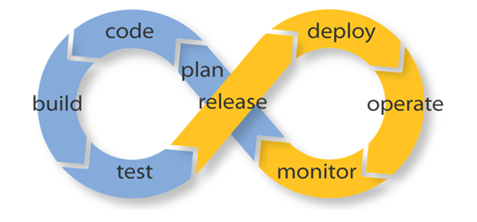
DevOps and BC/DR
Fast fail and rapid recovery
Parameterized deployment scripts and location agnostic templates
Optimizing compute/storage utilization and cost reduction
Implement and test resiliency and fault detection
Validate data integrity, consistency, and availability
Match DevOps principles with mature ITIL processes
Modernize outdated, expensive, and fragile BC/DR strategies
Continuously test backup and DR strategies
http://www.cio.com/article/3075277/disaster-recovery/how-to-master-disaster-recovery-in-a-devops-world.html
https://devops.com/companys-disaster-waiting-happen/
https://www.actifio.com/company/blog/post/6-questions-you-need-to-be-asking-about-your-disaster-recovery-plan/
http://www.computerworld.com.au/article/593813/devops-vs-itil/
http://searchservervirtualization.techtarget.com/feature/How-should-organizations-approach-the-DevOps-movement

Slide 56
General guidance
Design resilient applications
Azure Paired Regions
Availability Checklist
Retry general guidance
Retry service specific guidance

Slide 57
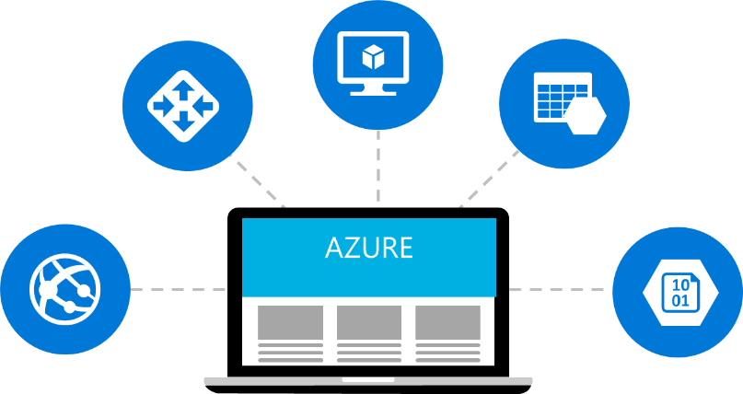
Links to other resources
Ignite 2018
BRK3335 session
SQL Server on Azure VMs
Overview
Configure high availability
HA and DR options
Configuring Always On availability group
Protecting data
Backup and restore
Automated backup
Using Azure storage for backup
Application patterns
App Services
Overview
Backup your app in Azure
Geo Distributed Scale
Automate backup and restore

Slide 58
Questions?

